Slide 1


DVD RENTALS DATA WAREHOUSE
IS 6480 Presentation
Group 6
Rilind Asllani
Zachary Blunt
Alec Halpin
Peter Pan

Slide 2

EXECUTIVE SUMMARY

Slide 3
INTRODUCTION
Businesses are operating in an ever-competitive environment
With innovation being one of the key factors that allows firms to not only stay afloat but to be at the cutting competitive edge ensures their ability to survive
At our firm we develop, implement, and service data warehouses that allow firms to analyze their business with ease, accuracy, and speed

Slide 4
WHAT NEED OUR FIRM FILLS
Our project will provide the end users with a new ability to analyze their business at the speed of thought via a data warehouse
Transactional databases are great but can be tricky for a vast amount of general business users or analysts to properly run SQL queries and generate consistent/accurate reports as all other analysts that use the same data
The data warehouse that we are proposing to build will ensure that the average individual in your business will be able to effectively run queries that will return consistent results throughout the firm at the speed of thought

Slide 5



WHY US OVER OUR COMPETITORS
· Our team sets and operates within a realistic timeline that ensures quick development and implementation allowing for your return on investment to arrive sooner than other competitors
· Our team’s superior communication skills and professionalism
· Complete trust in our firm’s ability to maintain your business’ sensitive information

Slide 6
EXECUTION PLAN/ READY FOR USE
First, we will enter into a planning stage, followed by requirement gathering, the data warehouse logical design, physical design, data integration, deployment, analysis, and then periodic maintenance
We will need constant communication throughout the entire process to ensure satisfaction
The data warehouse will be ready for use once we hit the deployment stage

Slide 7


ABOUT THE ORGANIZATION
The organization that we will be designing and implementing a Data Warehouse for is a DVD Rental company
This company provides customers with the opportunity to rent their favorite movies and TV shows to watch in the comfort of their own homes
Just like any other business, the goal of the DVD Rental company is to generate as much revenue as possible from its services
In order to meet this objective, the DVD Rental company must have a greater vision, which includes creating the most enjoyable experience possible for the customers
Want to generate a high turnover rate to increase revenues by incentivizing the customer return their DVD rental as quickly as possible

Slide 8

DIMENSIONAL MODEL REQUIREMENTS SUMMARY

Slide 9



PREPARING TO COLLECT REQUIREMENTS
In a meeting with mid-level managers, we determined that we would need to figure out what type of questions our data warehouse would address
We had two of our team members hold interviews between our team and the store employees to determine what types of business requirements were needed to develop our data warehouse
Upon further collection we determined the responsibilities the company had to their customers such as what the organization does and how it conducts its business
Notes:
In our preparation phase for the dimensional model requirements we would first contact management and develop an understanding of the data warehouse needs. We would also split our data warehouse team into groups and ask other non-management employees what type of business requirements they would like to see in the data warehouse structure. Once we have developed an understanding of how the organization works and what it does we could proceed to the next phase which is collecting requirements

Slide 10


COLLECTING BUSINESS REQUIREMENTS
When we started collecting business requirements, we first asked our stakeholders what they do and why they do it
Once we developed a description of what our stakeholders do and why they do it, we went through their last 12 months of business to determine how they adhered to our objective
Upon completion of the analysis of their procedures we finished by asking what their success criteria was for their business model
Notes:
Once we start collecting business requirements we would want to ask the company stakeholders what their company does and why they do it. To further understand and collect accurate business requirements we would then take a look at the last 12 months of business for the company to determine what our data warehouse objective should be, Once we have completed the following steps we would finally ask the company what their criteria for success is to understand what type of data the data warehouse should structure so that it can aide the business model and growth of the company.

Slide 11



COLLECTING DATA REQUIREMENTS
During the collection of the data requirements our objective was to determine and understand the feasibility of each business requirement based on the data we had available
According to the data rental database and the data available we determined that we could answer our business question: Revenue generated by rental sales
After considering the fact table: rental sales, we determined our dimension tables needed to develop a strong data warehouse
Notes:
If we weren’t given anything we would start collecting all the data we can from the company and then start developing our requirements with the data available. This entails considering what types of dimension tables we would need and what our fact tables are.

Slide 12


APPROACHES FOR COLLECTING REQUIREMENTS
To collect and analyze the data we need to develop a set of fact and dimension tables to determine the key components of our data warehouse
In addition, we need to develop a bus matrix to further understand how each business process is addressed by our dimensions
Notes:
Once we have the data in a raw format to process and structure it into the data warehouse we need to understand what we have so that we can work with it to develop and analyze proper fact and dimension tables that will be key components of our data warehouse. In addition, we would develop a bus matrix to split up the processes to make the data warehouse structure more manageable.

Slide 13

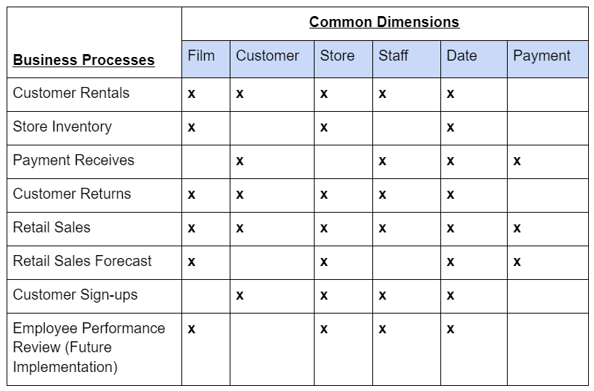
ANALYZING AND PRIORITIZING REQUIREMENTS
To further understand our impact and feasibility of requirements we require an analysis of our bus matrix to present and determine our requirements at a high level, break down each process into manageable pieces, and to understand any potential conformed dimensions
Bus Matrix
Notes:
Here is our bus matrix for our dvd rental data. We can see a list of business processes and the common dimensions related to each business process.All these dimensions would play a key role in our data warehouse to provide the structure we need to properly develop our data warehouse so that we can provide all the needed information to our fact tables.

Slide 14
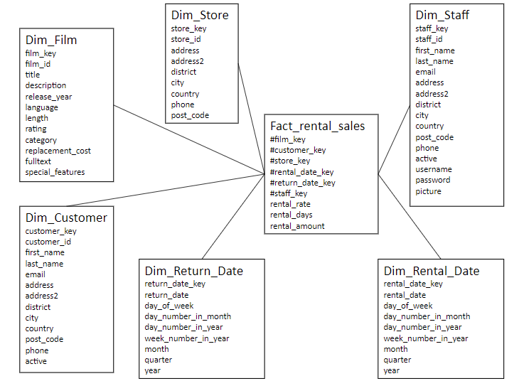
DIMENSIONAL MODEL
Notes:
Here we have our data warehouse dimensions and fact table, we decided to leave payment out because it didn’t provide any data we needed the original reason we had it was because of the payment date, however upon development of the data warehouse we found out that with our role playing date dimensions we didn’t need the payment dimension.

Slide 15
DIMENSIONAL MODEL
Film Dimension: The film dimension is important for analysis because we need to use the film key in the fact table so we can analyze which films are trending and make decisions as to what kind of films the DVD Rental company should buy
Store Dimension: helps us to identify all the stores and the cities they are in
Rental/Return Date Dimensions: An important feature of our dimensional model is that we have created role-playing dimensions, which play several roles simultaneously when used with our fact table
Notes:
A few key dimensions i’d like to mention are the film dimension, store dimension and our role playing dimensions (Rental and Return Date) each of these dimensions play a pivotal role in our data warehouse structure that allow us to analyze and develop a proper data warehouse and enables our teams to answer a variety of questions in metabase dashboards. This concludes the dimensional model requirements summary

Slide 16
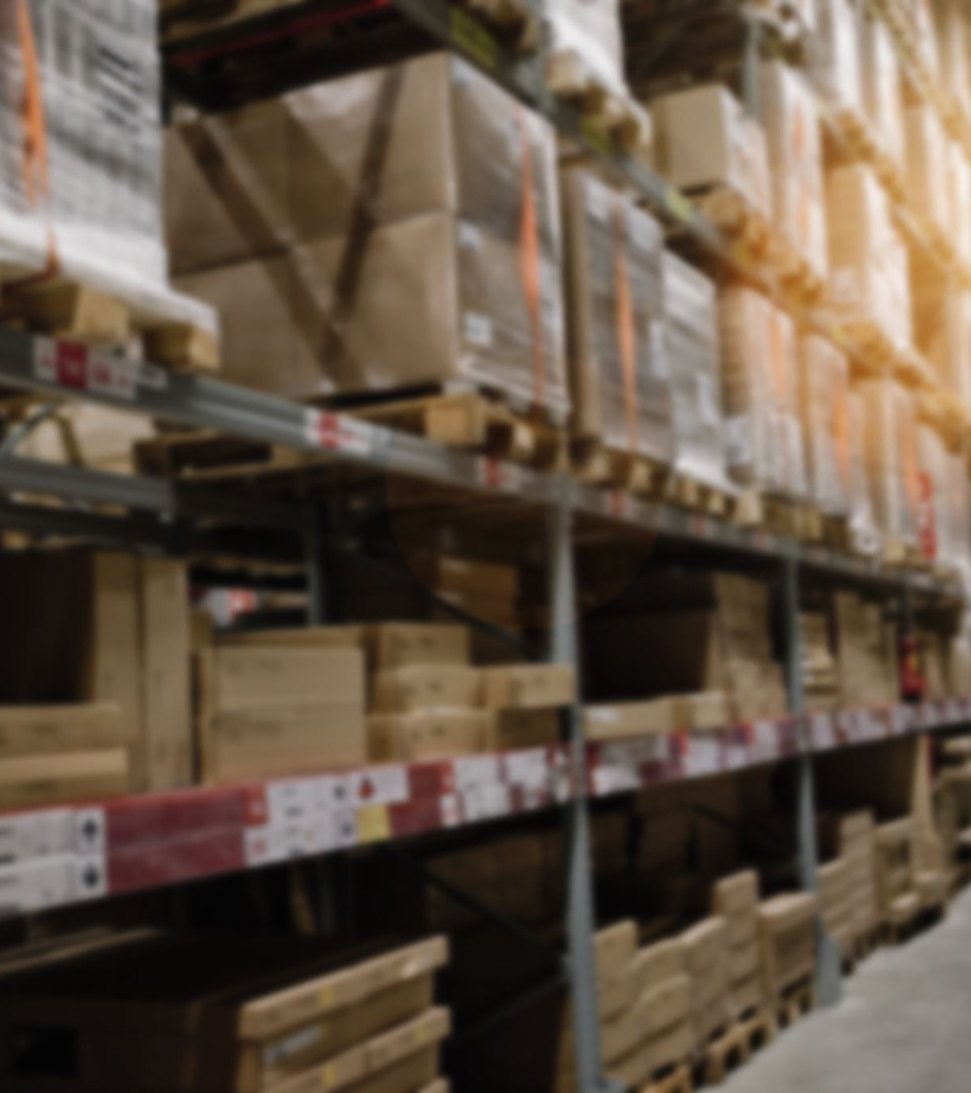
DATA WAREHOUSE CURRENT ARCHITECTURE

Slide 17





DATA SOURCE
Data Source
Data pipeline/ETL processes
Staging area
Presentation area
Security configuration
Reports/dashboards

Slide 18
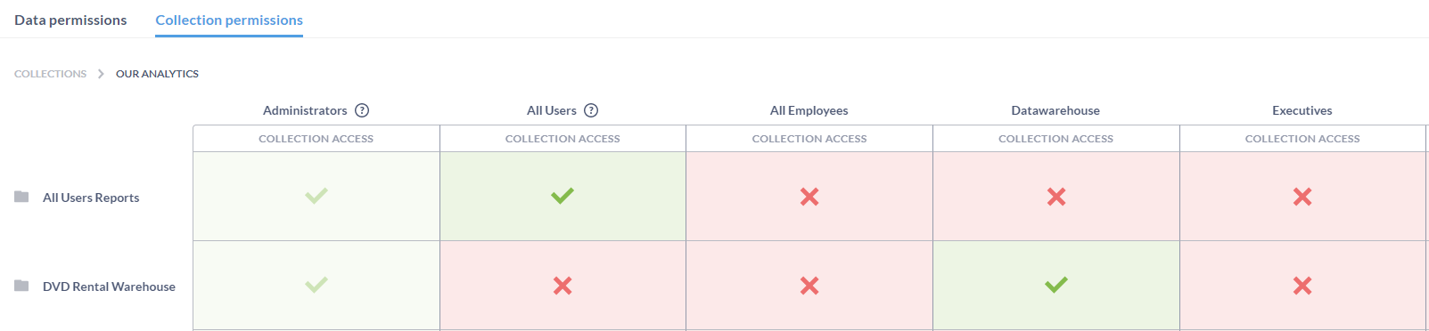
Security

Slide 19
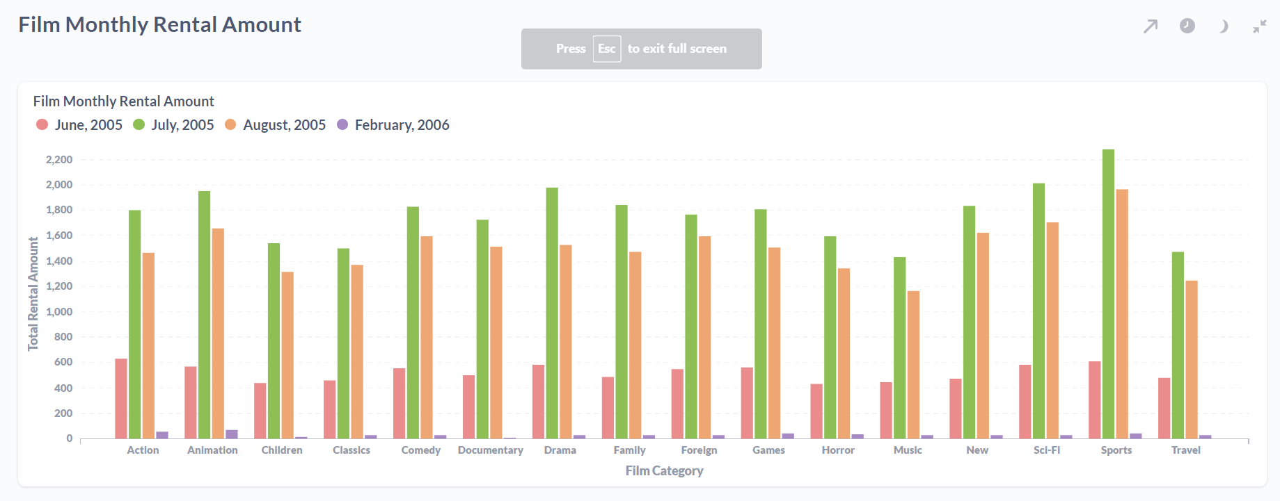
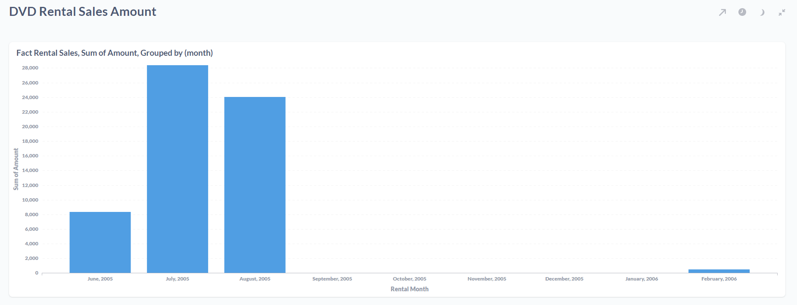
Dashboards

Slide 20
Future Reports, Dashboards, and Analyses
One of the future reports that our data warehouse is capable of handling would be to analyze the average duration of rentals​
This report would help with making decisions regarding the number of films we need to purchase to make sure we are meeting demand​
We would be able to create a report that details our customers that generate the highest revenues and from this create a marketing plan that targets our less frequent customers​
Another future report that could be implemented is an analysis of average rental costs per location​

Slide 21
Thank you for watching!

